Slide 1


ANALYZING THE EFFECTS OF ETHINYLESTRADIOL ON THE UTERUS OF ESTROGEN FREE RATS
NOVEMBER 1ST, 2019
BY
THE AVENGERS

Slide 2

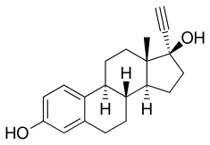
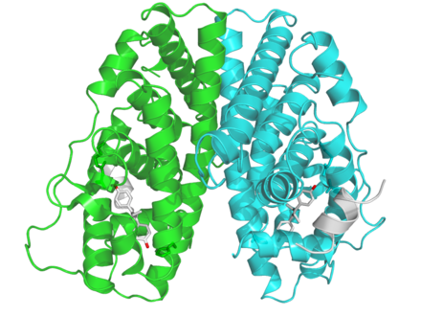
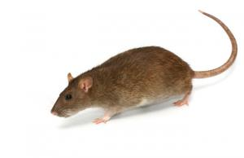

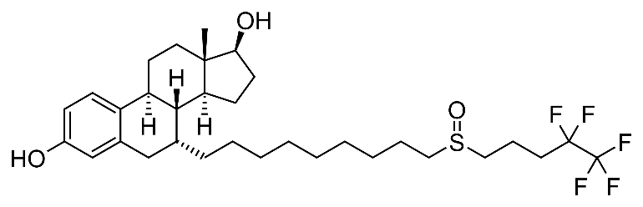
INTRODUCTION
Ethinylestradiol (EE)
Estrogen Receptor
Estrogen Antagonist
Uterus Weight

Slide 3
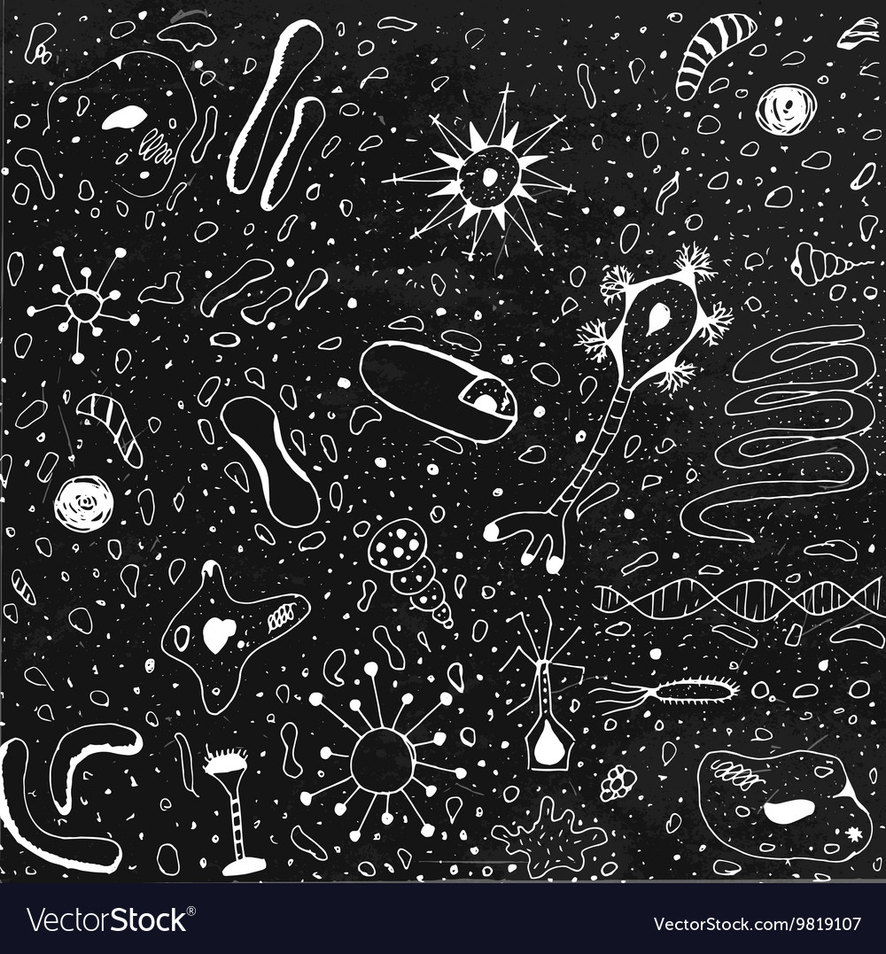
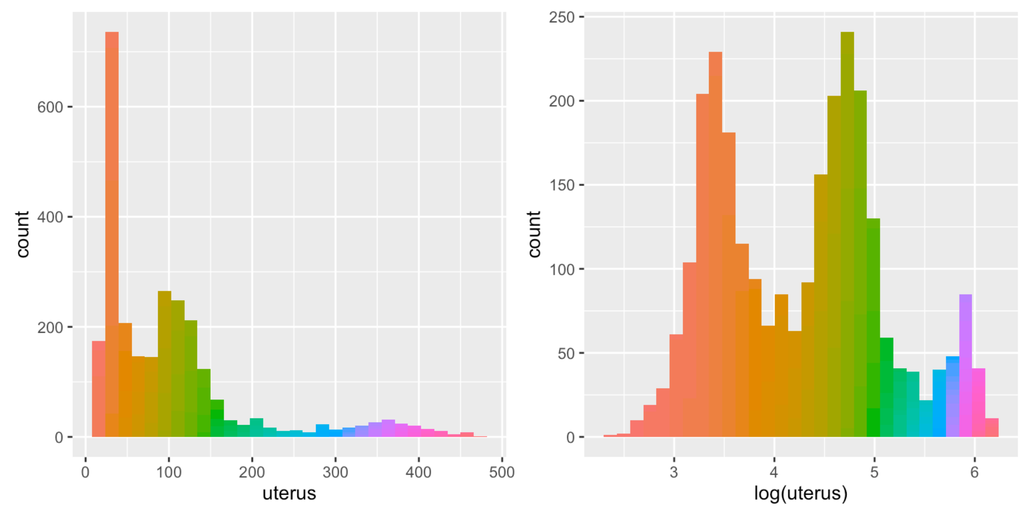
Exploratory Data Analysis

Slide 4
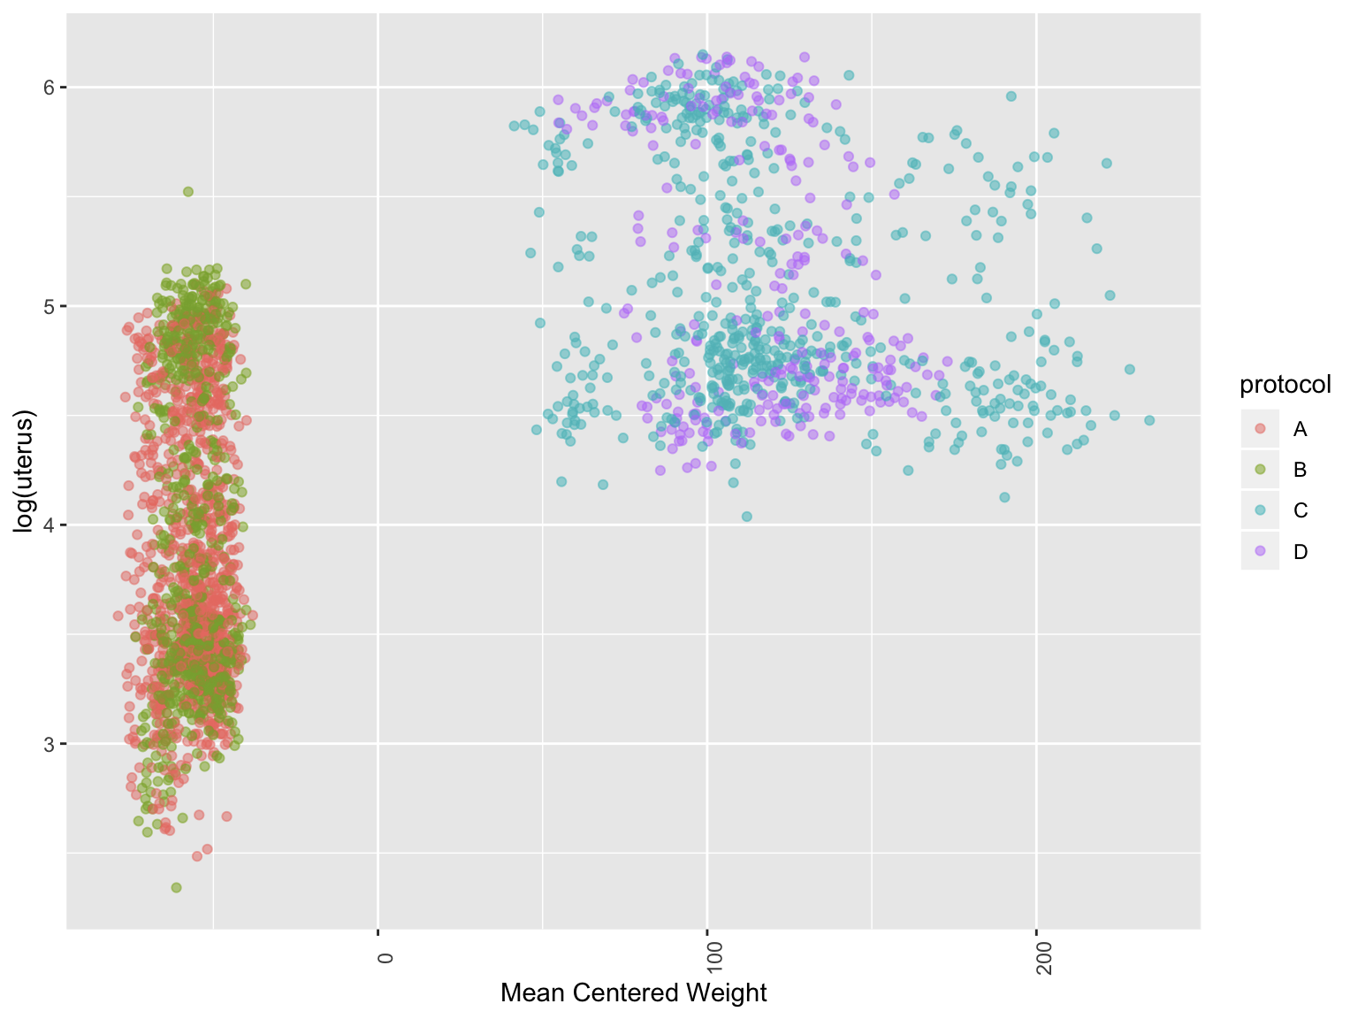
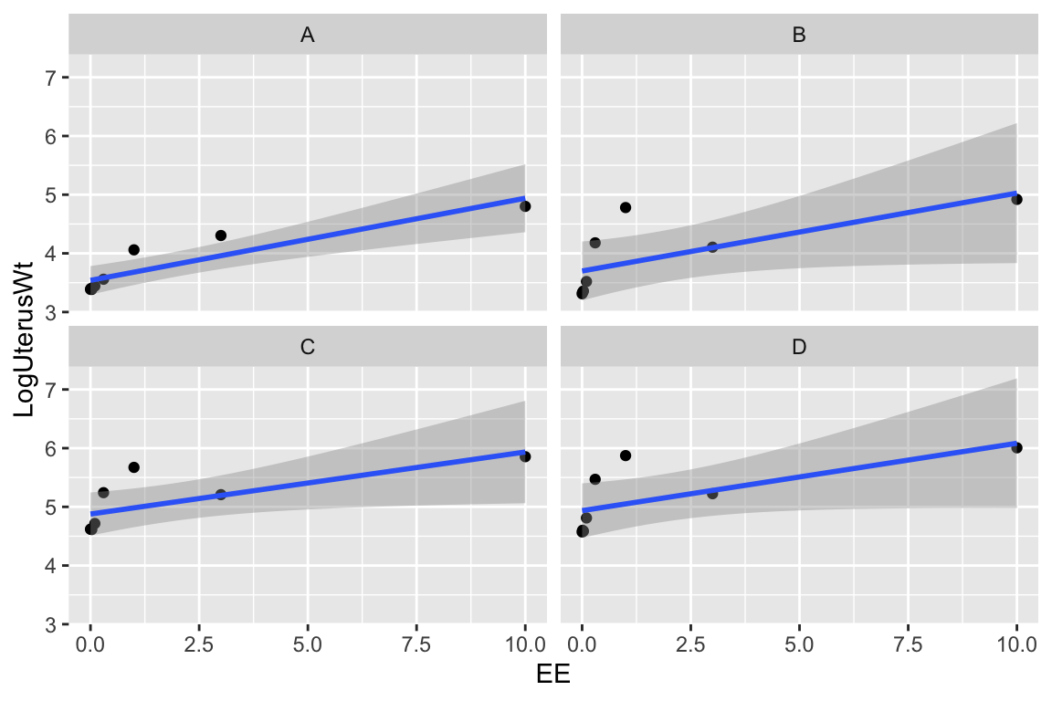

Slide 5

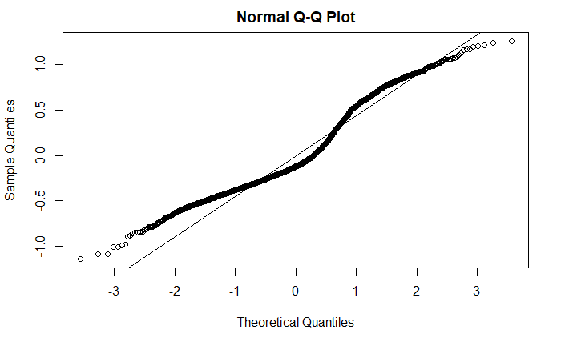

mODEL
${Log(y}_{ij})=\left( B_{0}+ {Lab}_{0j}\right)+ B_{1}{Weight}_{i}+ B_{2}EE_{i}+ B_{3}ZM_{i}+B_{4}Protocol_{i}+B_{5}EE_{i}:Protocol_{i}+ B_{6}ZM_{i}:Protocol_{i}$

Slide 6

RESULTS
Lab | Intercept
Basf | -0.28
Bayer | 0.01
Berlin | 0.04
ChungKor | 0.33
Citfranc | 0.20
Citijapa | 0.07
Denmark | 0.09
Exxon | 0.18
Hatano | 0.04
Huntingd | -0.19
InEnvTox | 0.01
KoreaPar | -0.25
Mitsubis | 0.06
Nihon | -0.04
Poulenc | -0.34
Sumitomo | 0.12
TNO | 0.05
WIL | -0.04
Zeneca | -0.04
Variable | Estimate | t Value
(Intercept) | 3.51 | 66.72
mweight | 0.00 | -1.78
EE | 0.15 | 32.74
ZM | -0.21 | -4.38
protocolB | 0.12 | 4.26
protocolC | 1.52 | 15.34
protocolD | 1.53 | 14.33
EE:protocolB | 0.00 | -0.13
EE:protocolC | -0.04 | -4.72
EE:protocolD | -0.03 | -2.45
ZM:protocolB | -0.63 | -8.83
ZM:protocolC | -0.30 | -3.80
ZM:protocolD | -0.54 | -5.14

Slide 7

CONCLUSION
EE ↑ uterus weight ↑
ZM ↑ uterus weight ↓
Uterus weights vary across laboratories; Chungkor and Poulenc show the most variation from the other labs
The protocols vary in their sensitivity to detect the differences in EE and ZM effects
Protocol B is the best protocol for determining these differences

Slide 8
LIMITATIONS
Need mixture effect model to improve normality
Need a control ZM group without any EE

Slide 9
SOURCES
https://www.ncbi.nlm.nih.gov/pmc/articles/PMC5715874/https://multco.us/health/staying-healthy/pest-prevention-and-control/ratshttps://bmcgenomics.biomedcentral.com/articles/10.1186/1471-2164-10-308https://en.wikipedia.org/wiki/Fulvestrant#targetText=Fulvestrant%2C%20sold%20under%20the%20brand,disease%20progression%20after%20endocrine%20therapy.https://en.wikipedia.org/wiki/Ethinylestradiol#targetText=Ethinylestradiol%20(EE)%20is%20an%20estrogen,symptoms%20in%20combination%20with%20progestins.

